Slide 1

Metarials and Methods :
1. MQ6 Gas Sensor
Function: The MQ6 gas sensor is the primary component used to detect LPG (liquefied petroleum gas) leaks. It operates by measuring the resistance change in its internal elements when exposed to LPG. The sensor outputs an analog signal proportional to the concentration of LPG in the air.
Features: High sensitivity to propane, butane, and LPG gases. It has a detection range of 200–10,000 ppm and operates on 5V.
MQ-6 sensor
2. ESP32 Microcontroller
Function: The ESP32 is the brain of the system, processing input from the MQ6 sensor and controlling various actuators such as the exhaust fan, buzzer, and servo motor. It also handles communication functions such as sending email notifications.
Features: Equipped with Wi-Fi and Bluetooth, it has multiple GPIO pins, ADC for reading analog signals from the sensor, and is highly energy-efficient, making it ideal for IoT applications. It runs on 3.3V but can accept inputs from 5V sensors.

Slide 2
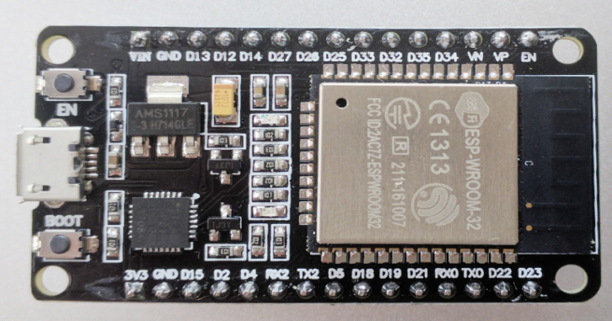

ESP 32 (Microcontroller)
3. Exhaust Fan
Function: The exhaust fan is used to ventilate the area in case of a gas leak. It helps to disperse the leaked gas and prevent its accumulation, which could otherwise lead to an explosion.
Control: The ESP32 activates the fan using a digital output pin.
Exhaust fan

Slide 3


4. Buzzer
Function: The buzzer provides an audible alert to warn people in the vicinity of a potential gas leak. The sound is loud and continuous until the system detects that the gas levels have returned to normal.
Control: The buzzer is controlled by the ESP32 through a digital output pin.
Buzzer
5. Servo Motor
Function: The servo motor is responsible for physically turning off the regulator knob of the LPG cylinder in case of a leak. It is programmed to rotate a specified angle to close the gas supply.
Control: The ESP32 sends PWM (Pulse Width Modulation) signals to control the angle of the servo motor.
Servo Motor

Slide 4
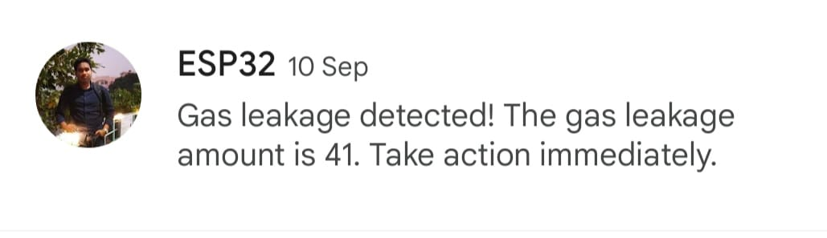
8. SMTP Service for Email Notification
Function: The ESP32 connects to the internet via Wi-Fi and uses an SMTP (Simple Mail Transfer Protocol) service to send email alerts in the event of a gas leak. The mail server details are configured in the code to send emails to pre-defined recipients, ensuring remote alerts.

